Slide 1

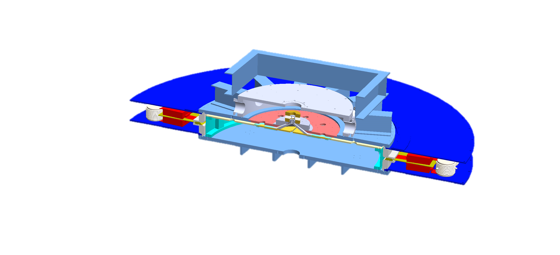
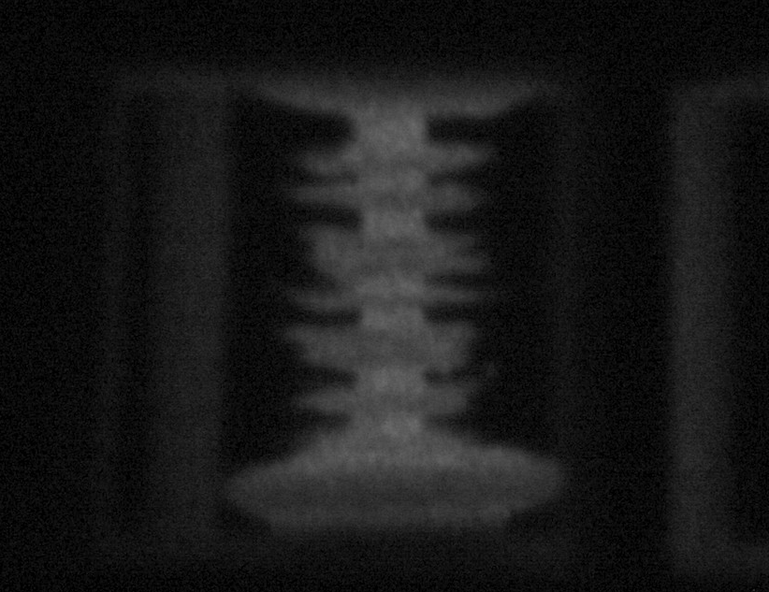
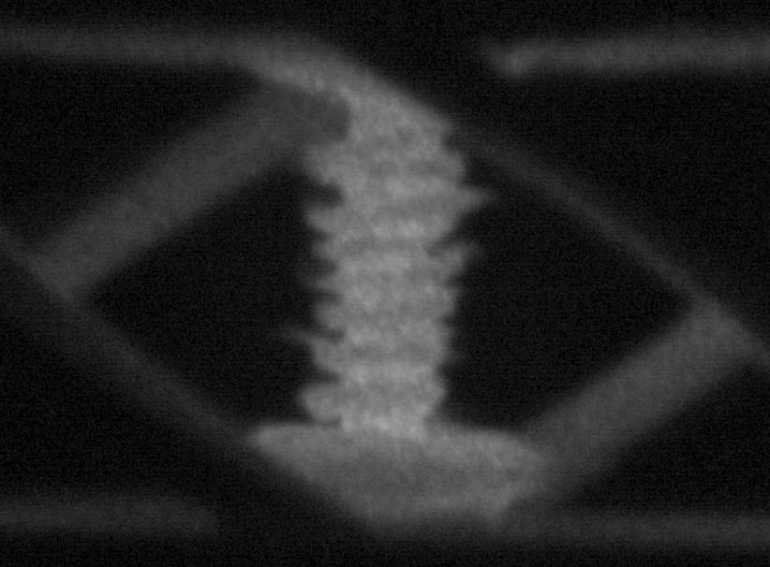
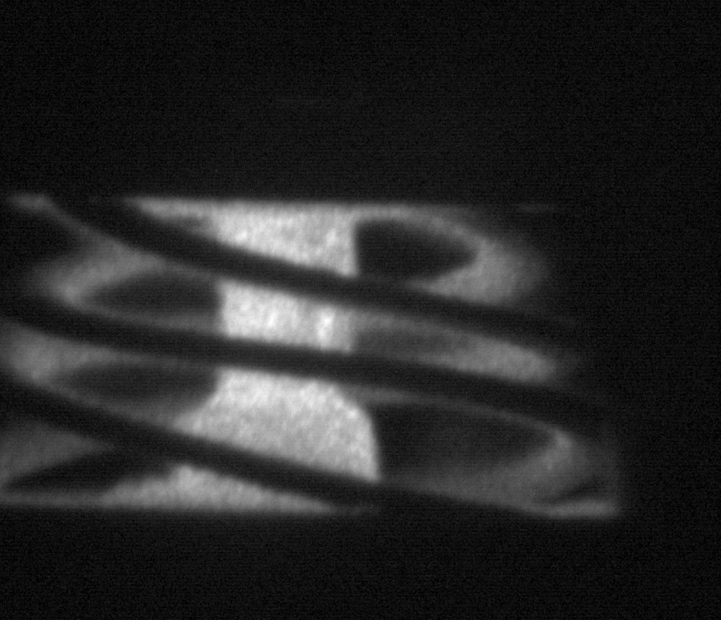
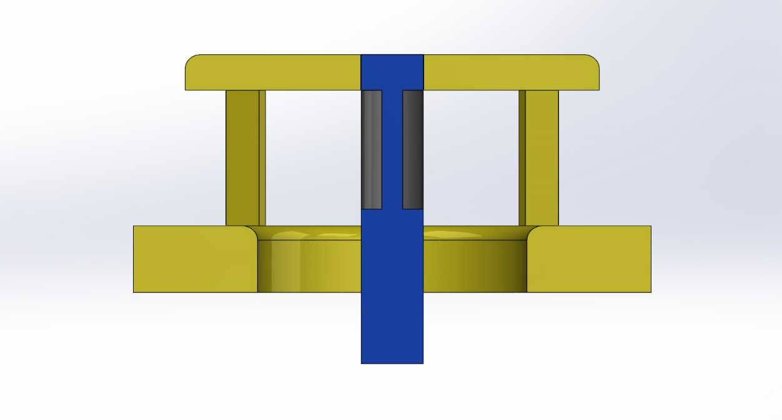
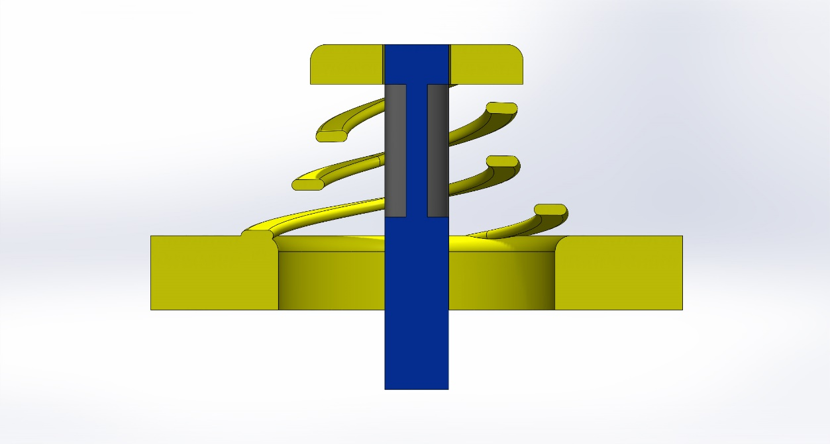
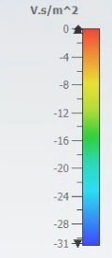
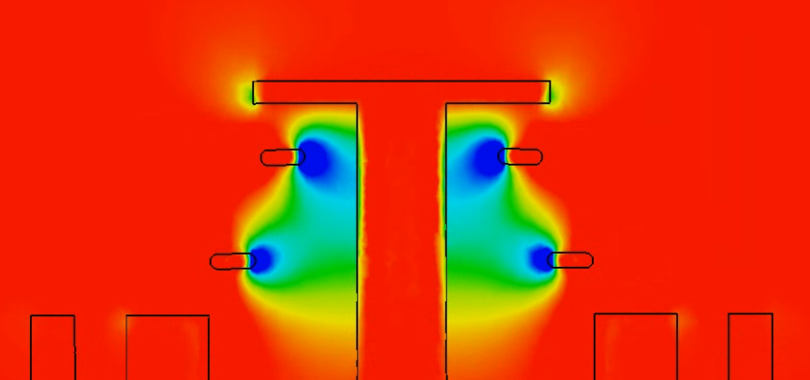


Stability Analysis of Dynamic Screw-Pinch Driven Thin-Foil Liner Implosions
A. Bedel, J. Chen, L. Tafoya, N. M. Jordan, and R. D. McBride
Nuclear Engineering and Radiological Sciences, University of Michigan
MAIZE Linear Transform Driver
Experimental Results
This is written in 24 pt. font.
24 shots, Flux compression,
geo specifications
LTD, rise time, MA
The Dynamic Screw-Pinch
Diagnostics
Conclusions & Future Work
3 DSP Designs
Bz/Bt
Magnetic Pitch Angle
Pitch equation
Rogowski, 12-frame FFC, x-ray pinhole
[1] R. M. Gilgenbach, M. E. Read, K. E. Hackett, R. Lucey, B. Hui, V. L. Granatstein, K. R. Chu, A. C. England, C. M. Loring, O. C. Eldridge, H. C. Howe, A. G.Kulchar, E. Lazarus, M. Murakami, and J. B. Wilgen, “Heating at the Electron Cyclotron Frequency in the ISX-B Tokamak,” Phys. Rev. Lett., vol. 44, no 10, pp. 647-650, Mar. 1980.
[2] N. Friedman, "The Naval Institute Guide to World Naval Weapon Systems", 5th ed. Naval Institute Press, 2006.
[3] W. C. Brown, "Description and Operating Characteristics of the Plantinotron - A Microwave Tube Device." Proceedings of the IRE. Vol 45. Sept 1957.
[4] E. C. Okress. “Microwave Power Engineering: Generation, Transmission, Rectification”, Volume 1. Academic Press. 1968.
[5] S. C. Exelby Jr., “Recirculating Planar Crossed-Field Amplifiers”, University of Michigan, Ph.D. Dissertation, 2019.
[6] S. C. Exelby Jr. et al. “High-Power Amplification Experiments on a Recirculating Planar Crossed-Field Amplifier”, IEEE Transactions on Plasma Science, vol. 48, pp. 1917-1922, June 2020.

